Slide 1
Infosys Springboard · Team D
PredictIQ
A small predictive-maintenance tool we built to see if a model could tell a healthy machine from a failing one — and say so before it breaks down.
Predict — Prevent — Perform
github.com/Charankumm/InfosysSpringBoard-Team-D

Slide 2
Why bother with this
Most machines don't warn you before they fail.
Plants usually run one of two playbooks: fix it once it's broken, or service it on a fixed calendar whether it needs it or not. Neither one actually looks at what the machine is telling you.
Reactive
wait for it to break
downtime + emergency repair costs
Scheduled
service on a fixed calendar
wastes labor on parts that were fine
Predictive — ours
watch the sensor data
flag risk before failure, service only when needed
The Problem
02

Slide 3
What we built
Six things PredictIQ actually does
—
Reads live machine readings
—
Sends an email the moment it's critical
temperature, torque, speed, tool wear — entered or streamed in
so nobody has to be staring at a screen
—
Predicts failure probability
—
Shows it all on one dashboard
and the likely failure type, not just a yes/no
health score, gauge, trend, AI notes
—
Flags anomalies early
—
Keeps a history
before a reading crosses into outright failure
so you can see how a machine trended over time
Features
03

Slide 4
Under the hood
Sensor in, decision out
IoT Sensors
Ingestion
Processing
ML Models
Prediction
Dashboard + Alerts
raw machine readings
Kafka / MQTT
Spark / Flink
XGBoost, LSTM, RF
failure probability
what the user sees
Sensors feed a queue, a processing layer does the heavy lifting, the model scores the reading, and the result lands on the dashboard — with an email firing automatically if it's critical.
Dashboard
Email alert
PDF report
live gauge + trend chart
fires automatically, confirmed working
downloadable summary
Architecture
04

Slide 5
What it's made of
The stack
Backend
Python, Flask / FastAPI
Machine learning
Scikit-learn, TensorFlow, XGBoost, Random Forest, LSTM
Data processing
Apache Kafka, MQTT, Apache Spark, Apache Flink
Frontend
HTML5, CSS3, JavaScript (ES6), Chart.js
Database
time-series DB
Notifications
Email (live), Slack + SMS (planned)
Tech Stack
05

Slide 6
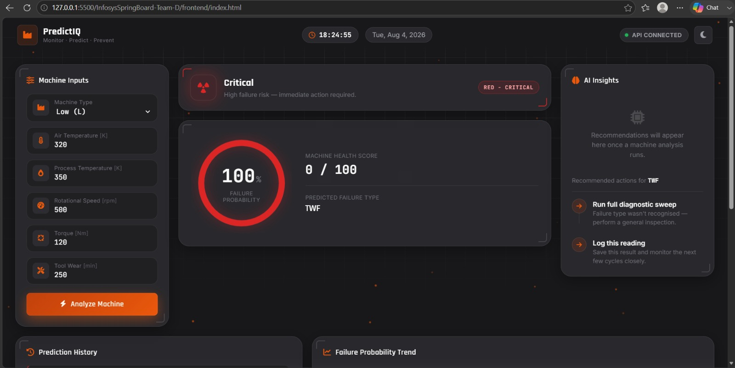
First test run
We fed it a bad reading —
it caught it.
Low-torque input with high tool wear. The model called it correctly and flagged the exact failure mode.
Failure probability
100%
Health score
0 / 100
Failure type
TWF — tool wear
localhost — dev build, Aug 4
Dashboard
06

Slide 7
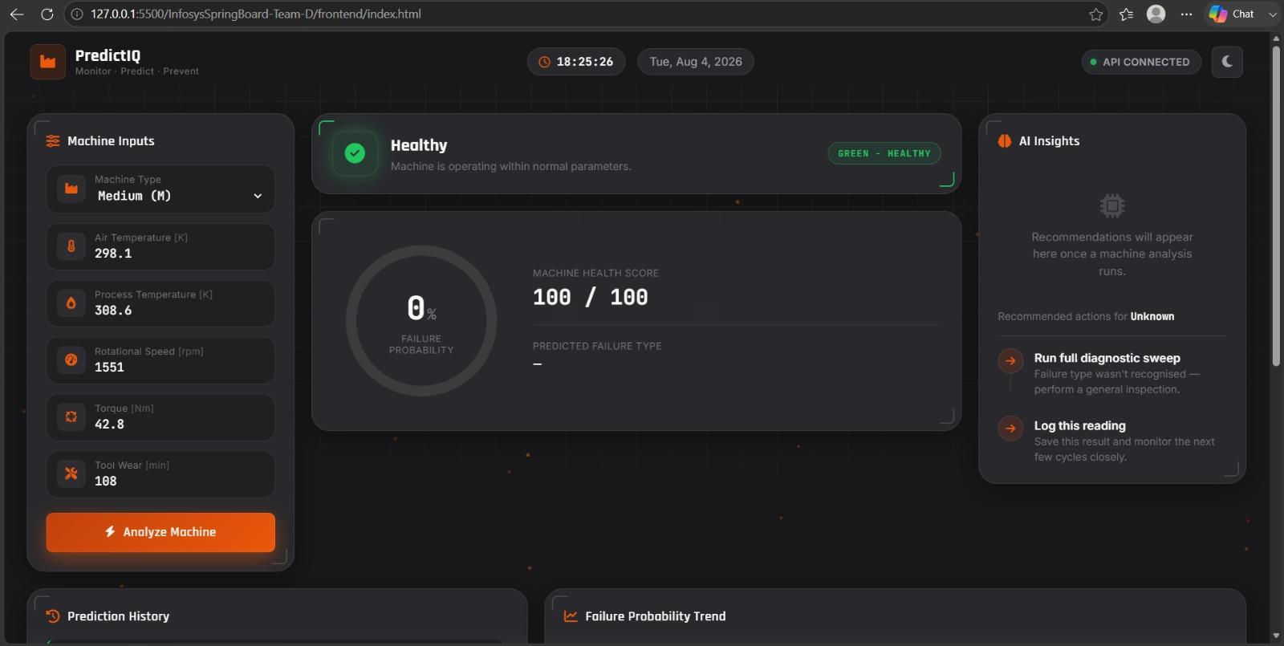
Second test run
Then a normal reading —
and it stayed quiet.
Same model, same session, ordinary parameters this time. It didn't cry wolf — good sign it's actually discriminating, not just alarming.
Failure probability
0%
Health score
100 / 100
localhost — dev build, Aug 4
Failure type
— none flagged
Dashboard
07

Slide 8
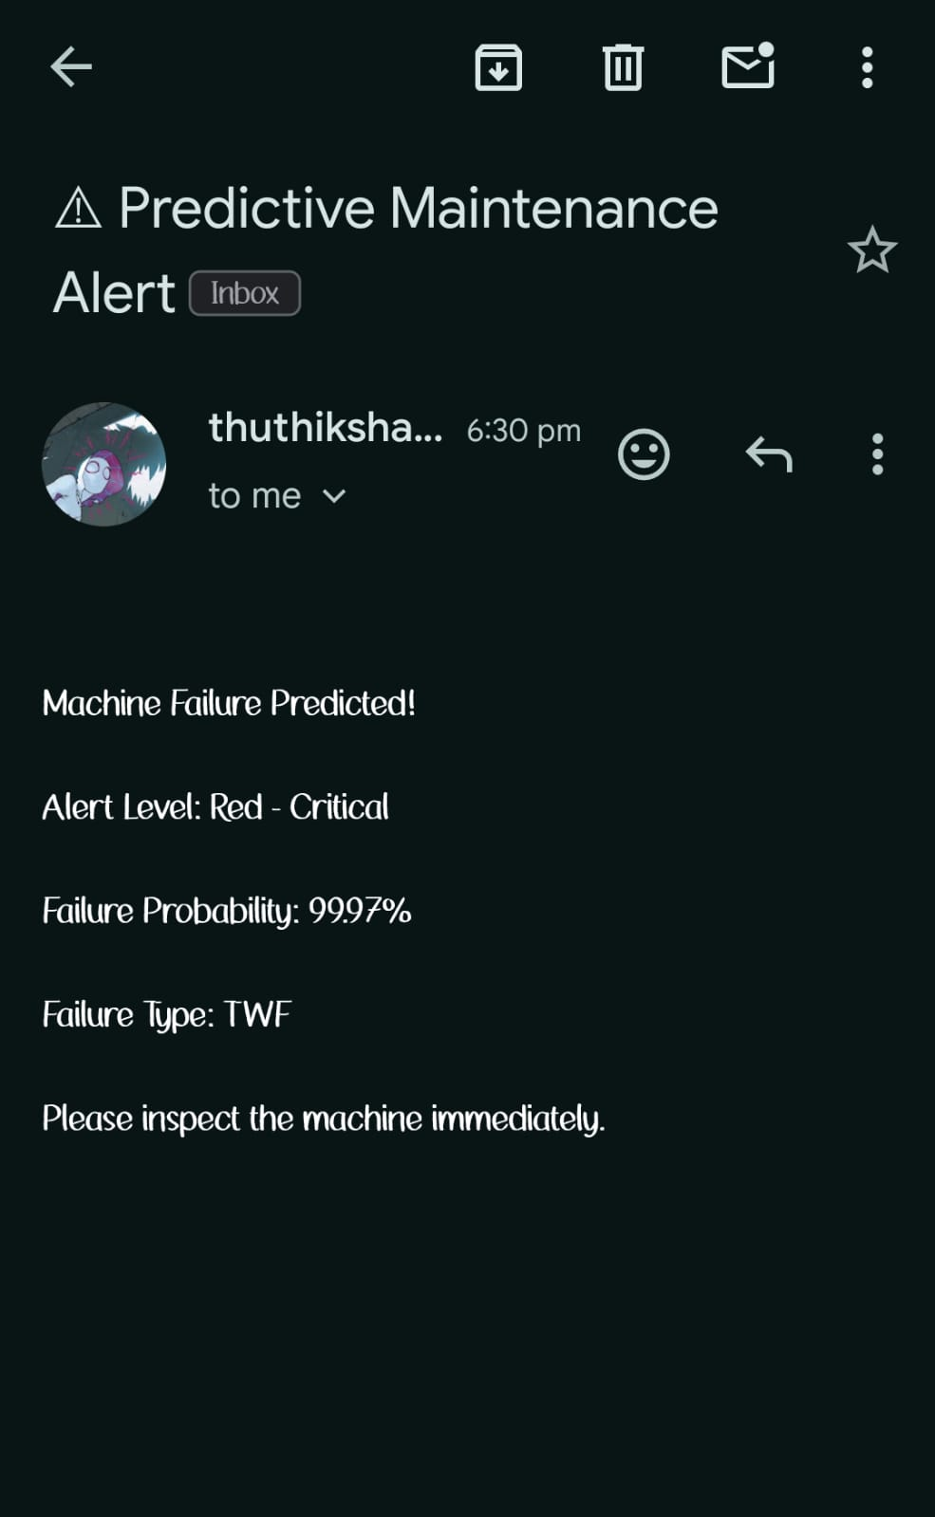
It doesn't need babysitting
The alert email is real —
this is an actual inbox.
When a reading crosses into critical territory, the Flask backend fires an SMTP email on its own — no cron job someone has to remember to check.
Trigger
probability crosses the critical threshold
Payload
probability, failure type, an action prompt
Working now
email, end-to-end
Not yet
Slack and SMS are still just planned
Alerts
08

Slide 9
What it learned from
Data & the ML pipeline
Datasets
Pipeline
AI4I 2020
the one actually driving the current model
Collect → clean → engineer features → train → predict RUL → catch anomalies → serve live → retrain as new data comes in.
NASA C-MAPSS
turbofan degradation
CWRU Bearing
bearing vibration
Azure PdM
Microsoft's predictive maintenance set
Models saved: machine_failure_model · failure_type_model · label_encoder
Data & ML
09

Slide 10
Start to finish
What happens on one reading
1
Someone enters the machine's numbers
on the dashboard form
2
The frontend calls the Flask backend
over a plain REST request
3
The model scores it
returns a failure probability and a type
4
The dashboard updates
gauge, trend chart, AI notes
5
If it's critical, an email goes out
automatically, no one has to trigger it
6
The reading joins the history
for later trend review and a PDF report
Workflow
10

Slide 11
Where things stand
Honestly, about 78% there
The core loop — read a machine, score it, show it, email it — works end to end. What's left is mostly plumbing: live sensor ingestion and a real place to store history.
78%
Working
Left to do
Nice-to-haves
·
Dashboard UI — inputs, gauge, AI notes
·
MQTT so it reads live sensors, not manual entry
·
Kafka + Spark/Flink layer (still just on paper)
·
Flask backend, live API connection
·
A real database for prediction history
·
PDF export, Slack & SMS alerts
·
Failure prediction — probability + type
·
History surviving past one session
·
Digital twin, edge deploy, mobile app
·
Healthy vs. critical, checked both ways
·
Email alert fires automatically
Status
11

Slide 12
What's next
If we keep going
NEXT UP
MQTT + live sensors
swap the manual form for a real IIoT stream
NEXT UP
A real database
stop losing history when the session ends
LATER
Prescriptive maintenance
move from "here's the risk" to "here's what to do"
LATER
Digital twin
simulate the machine alongside the live feed
SOMEDAY
Edge AI
run inference closer to the machine itself
SOMEDAY
Cloud + mobile
hosted backend, a monitoring app in your pocket
What's Next
12

Slide 13
Thanks for reading
PredictIQ — built by Team D for the Infosys Springboard Internship Program.
github.com/Charankumm/InfosysSpringBoard-Team-D

